Slide 1

Predicting San Jose Home Prices
AARON LOPEZ
CAPSTONE PROJECT JUNE 2017

Slide 2

The Problem
Mayor…"San Jose is facing an affordable housing crises.”
The average home now costs $1 million in San Jose
Are affordable housing policies working? ¯\_(ツ)_/¯
What should the first time home buyer do in the near term? ¯\_(ツ)_/¯
Notes:
There are two major client groups. First, the city of San Jose who has made housing affordability a priority as the city continues to grow and city officials create urban planning policy. Local leaders have expressed their desire to introduce an implement policy to make housing more affordable for low and middle-income residents. Understanding the trend and where housing prices are headed will help politicians determine what policy may be needed or developed. The second group of clients would be low and median income individuals seeking to find affordable housing. This information can help them make an informed decision on when and if to purchase a home in the near future.

Slide 3
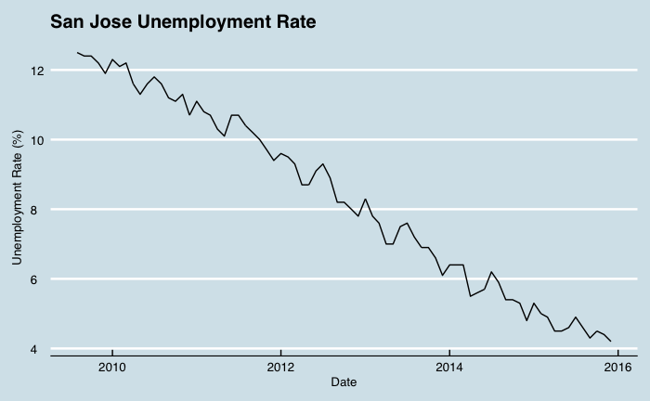
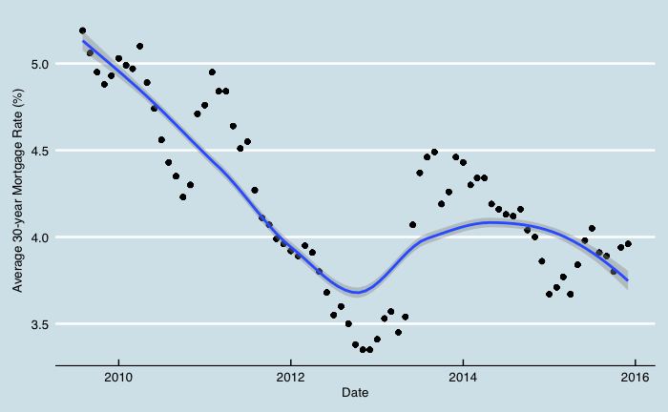
HOW DID WE GET HERE?
Post financial crisis 2007-2008
Rebound in the housing market
Low mortgage rates
High demand for Silicon Valley real estate

Slide 4
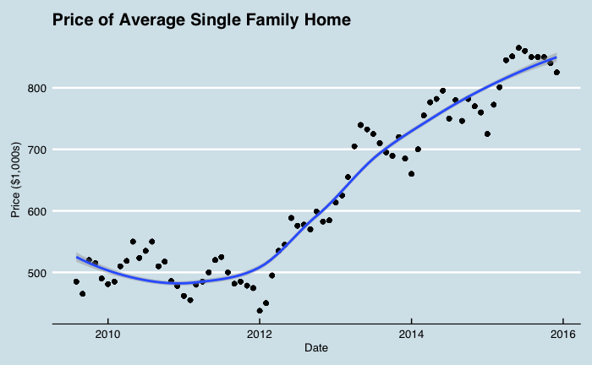
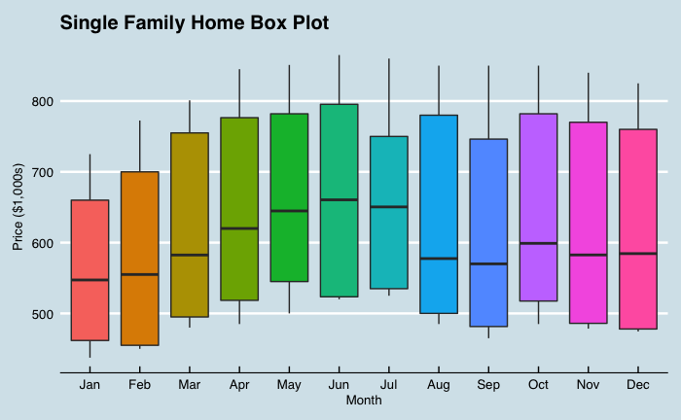
HOW DID WE GET HERE?
70% increase in average home prices since 2011 in San Jose
Local government policy, is it working?
Where will house prices go from here?

Slide 5
Approach to prediction
Predicting near term home prices will help track government affordable housing policy and assist potential home buyers
I will use three different models and determine which one is the best predictor of average home prices
Linear Regression
Tree Regression
ARIMA (autoregressive integrated moving average)
To determine the best predictor I will compare the root-mean-square error (RMSE) of each model, lowest score gives the most accurate predictions
Notes:
Now that we've taken some time to do some analysis I'm going to look at three different models and determine from test data which one does the best job at predicting average home prices. To compare each model I'll use root-mean-square error (RMSE) results. RMSE measures the square root mean differences between the values our models predict and the actual values from the test data set. The model with the lowest RMSE corresponds to the model with the best predictive accuracy. To compare each model fairly we will use the test data set from the time-series model since we cannot use randomly selected test data for a time-series model.

Slide 6
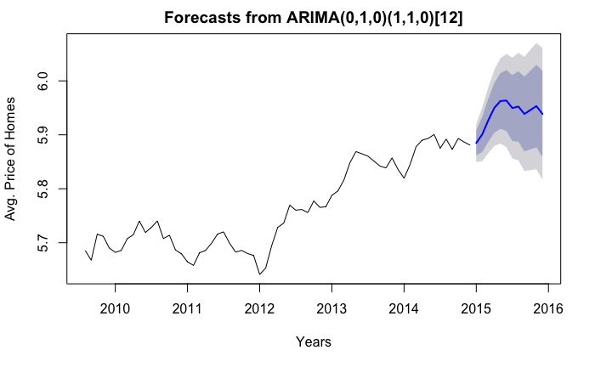
Approach to prediction
ARIMA (autoregressive integrated moving average)
This is a time series model
Past data to predict future data
RMSE 0.022528 (good)

Slide 7
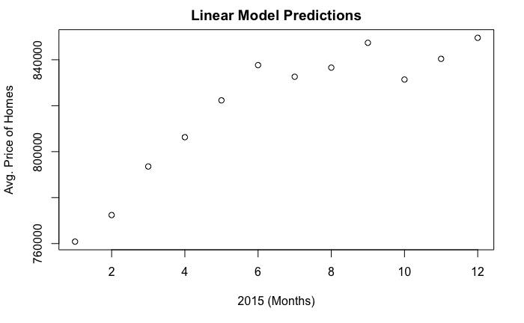
Approach to prediction
Linear Regression Model
Line of best fit to predict future prices
Variables include unemployment rate, mortgage rates, and average apartment rents
RMSE 0.012206 (better)

Slide 8
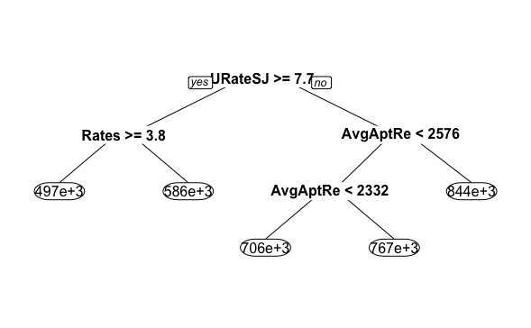
Approach to prediction
Tree Regression Model
Decision trees
Random data used to train and test the model predictions
RMSE 0.001140 (best)

Slide 9
Results and discussion
Average home prices are likely to increase in the near term
Seasonal trends reveal the best time to buy a home is in Jan/Feb and best time to sell is Jun/July
Further examination of government policy effects is needed
Model can be used to determine the effectiveness of new policies over time by tracking and predicting home prices
Gathering more relevant variables for a more robust data set will help improve the accuracy of the model
Notes:
After analyzing the data set and working through building our models to predict average home prices for San Jose there are a few takeaways for our client groups. First, in the near term housing prices will continue to rise. For someone looking to buy a home it may be advantages to wait until prices fall if buying a home isn't a short term necessity. Secondly, when the time comes to purchase a new home it may be more beneficial to buy during the winter months when seasonal trends show prices to be the lowest. This could save buyers a substantial amount of money compared to purchasing a home during the summer months. Lastly, from a government policy perspective, it seems as though current initiatives to create affordable housing for more people aren't having a significant impact on average home prices. However, it is hard to say definitively since this data set is limited and more variables would need to be considered. Further analysis should be done by the city of San Jose to measure the impact of policy initiatives to verify they are working as intended. The subject of affordable housing will continue to be of interest in cities with limited space and growing populations. San Jose is at the heart of Silicon Valley where innovation and wealth creation thrive, making the area a very popular and expensive place to live. Affordable housing will continue to be an issue for the businesses and people who live in San Jose.

